Slide 1

RESTAURANT EXQUISITE
LANDING PAGE
BY
KORADA VIJAYA ANJALI
ADITYA UNIVERSITY
21A91A6148

Slide 2
INDEX
INTRODUCTION
TECHNOLOGIES USED
METHODOLOGY
DEPLOYMENT
RESULTS
CONCLUSION

Slide 3

01. Introduction
Front-End development involves designing and coding the visual elements that users interact with directly.
My project is about a restaurant website through which we can make reservations for particular time and particular date and we can order online also.
The flexibility of my project is we can order multiple food items with different address at a same time.

Slide 4

02.TECHNOLOGIES USED
HTML (Hyper text markup language)
CSS (Cascading Style Sheet)
JAVA SCRIPT
AWS cloud (ec2 instance)
APACHE server.

Slide 5
03. METHODOLOGY
Objective Definition: Clearly defining the goals and objectives of the project.
Scope Determination: Outlining the features and functionalities to be included in the project.
Technology Selection: Identifying and selecting the technologies and tools needed for the development process I choose HTML, CSS, JS, AWS EC2.
Designing: Creating design mockups and wireframes to visualize the user interface and overall structure.
Development: Writing code and developing the actual project based on the established plan and design.
Testing: Conducting various types of testing (unit testing, integration testing, user testing) to ensure the project meets its requirements.
Deployment: Choose any cloud for deploying the website and access it through the internet I opted AWS for this project.
Final Testing: Final testing using the ip address and see the website responsiveness.

Slide 6
04. DEVELOPMENT
HTML (HyperText Markup Language): Defines the structure of web pages using markup.
CSS (Cascading Style Sheets): Controls the appearance and layout of web pages, including colors, fonts, and positioning.
JavaScript: Adds interactivity and dynamic behavior to web pages, such as animations, form validation, and asynchronous data loading.
Deployment in AWS ec2 instance first launch the instance and install a server and deploy it. Using public IP we can access our website in internet.

Slide 7
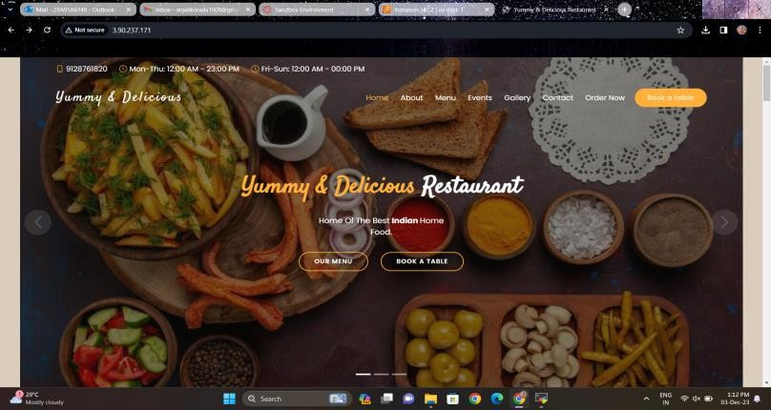
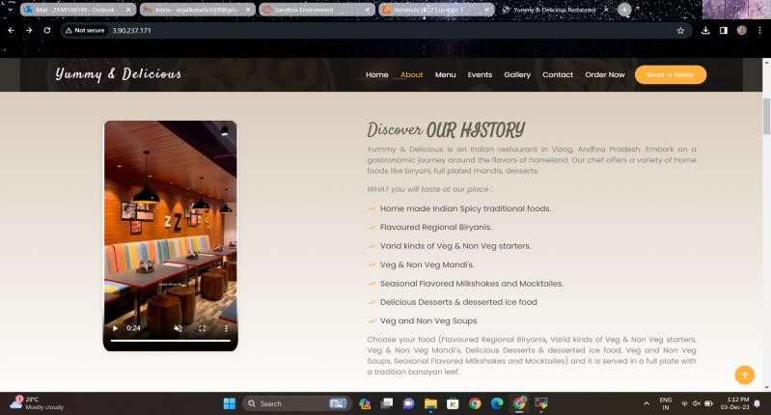
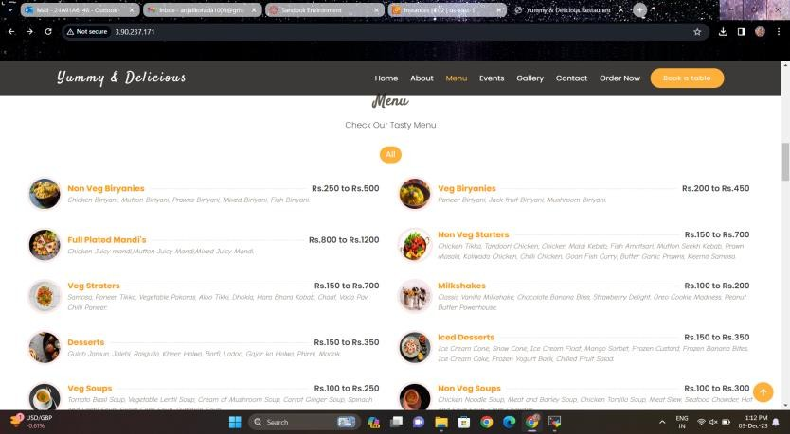
05.RESULTS

Slide 8
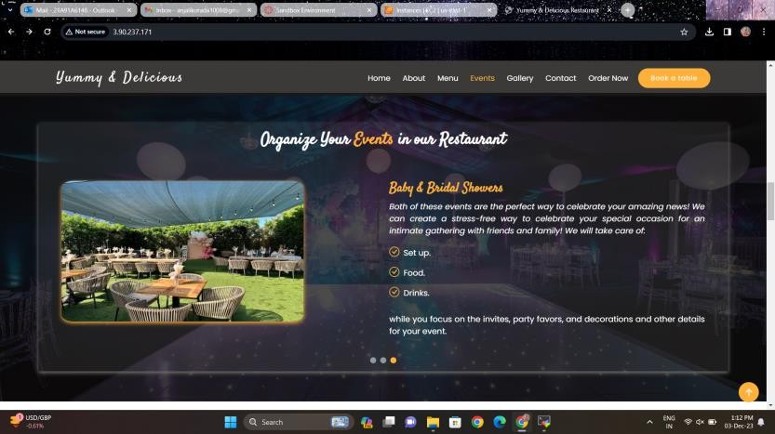
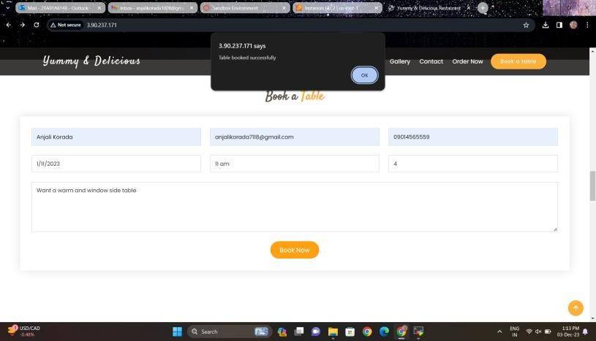
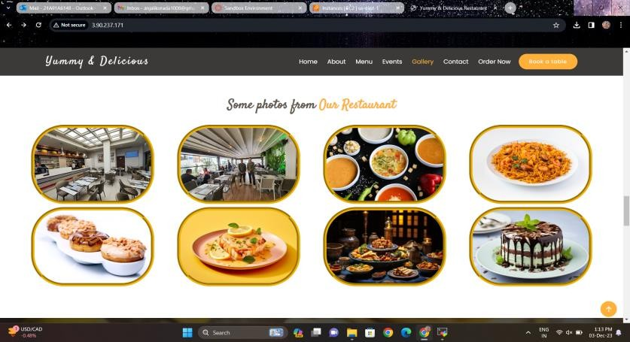
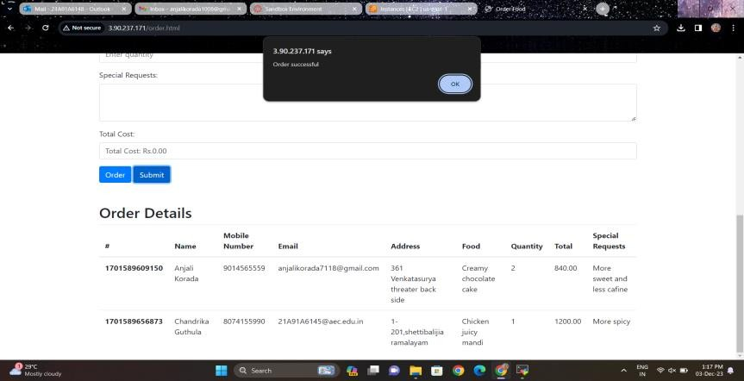

Slide 9
06. CONCLUSION
Responsive Design: The restaurant landing page was meticulously designed to ensure a responsive user experience across various devices. The use of modern web development practices and technologies contributed to the creation of an pleasing interface.
User-Friendly Navigation: Emphasis was placed on creating an intuitive navigation system, allowing users to effortlessly explore the menu, view restaurant information, and place orders.
Online Ordering System: The implementation of an online ordering system was a pivotal aspect of the project.
Booking a table: Book a table at specified time and specific date at your preference spot for dining and organize the events like birthdays, receptions, graduation parties etc.

Slide 10


